Slide 1


Introduction to Cascading Style Sheets (CSS)
By: Harsh Bardhan Mishra⚡

Slide 2
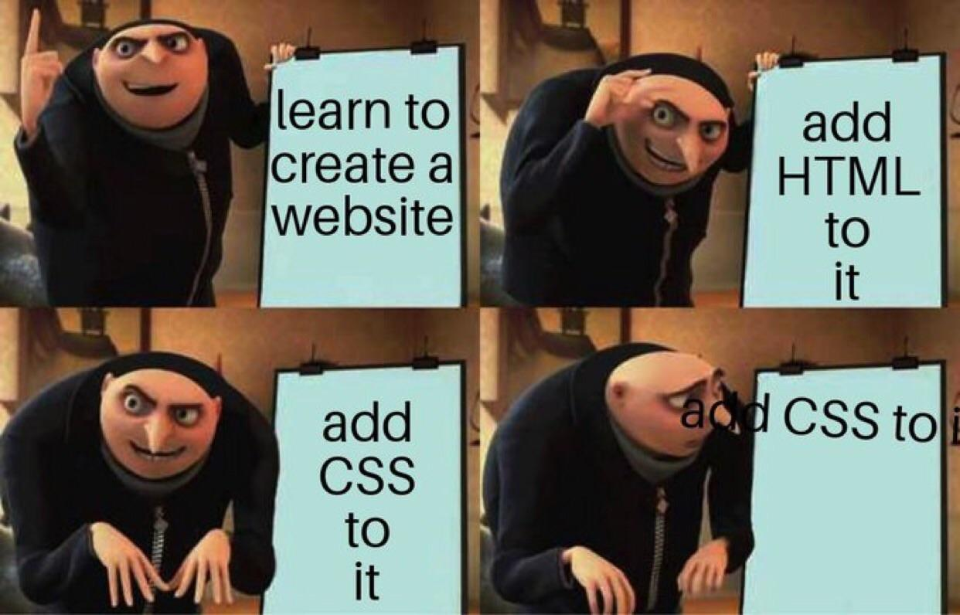
What is CSS ?
⚡Design your Website using CSS.
⚡Make it visually appealing.
⚡Add Animations and more using CSS
⚡Customize your HTML Structure as per your desire

Slide 3
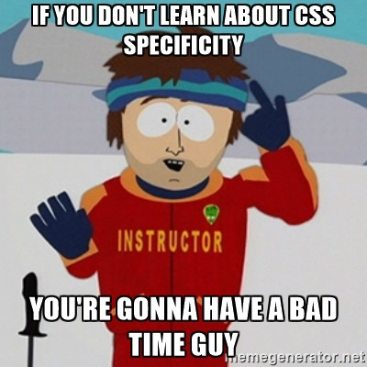
What CSS isn’t ?
⚡ It is not a Programming Language.
⚡It is not Easy.
⚡It is hard to Debug and difficult to maintain.
⚡Devs don’t like to do CSS stuffs.

Slide 4
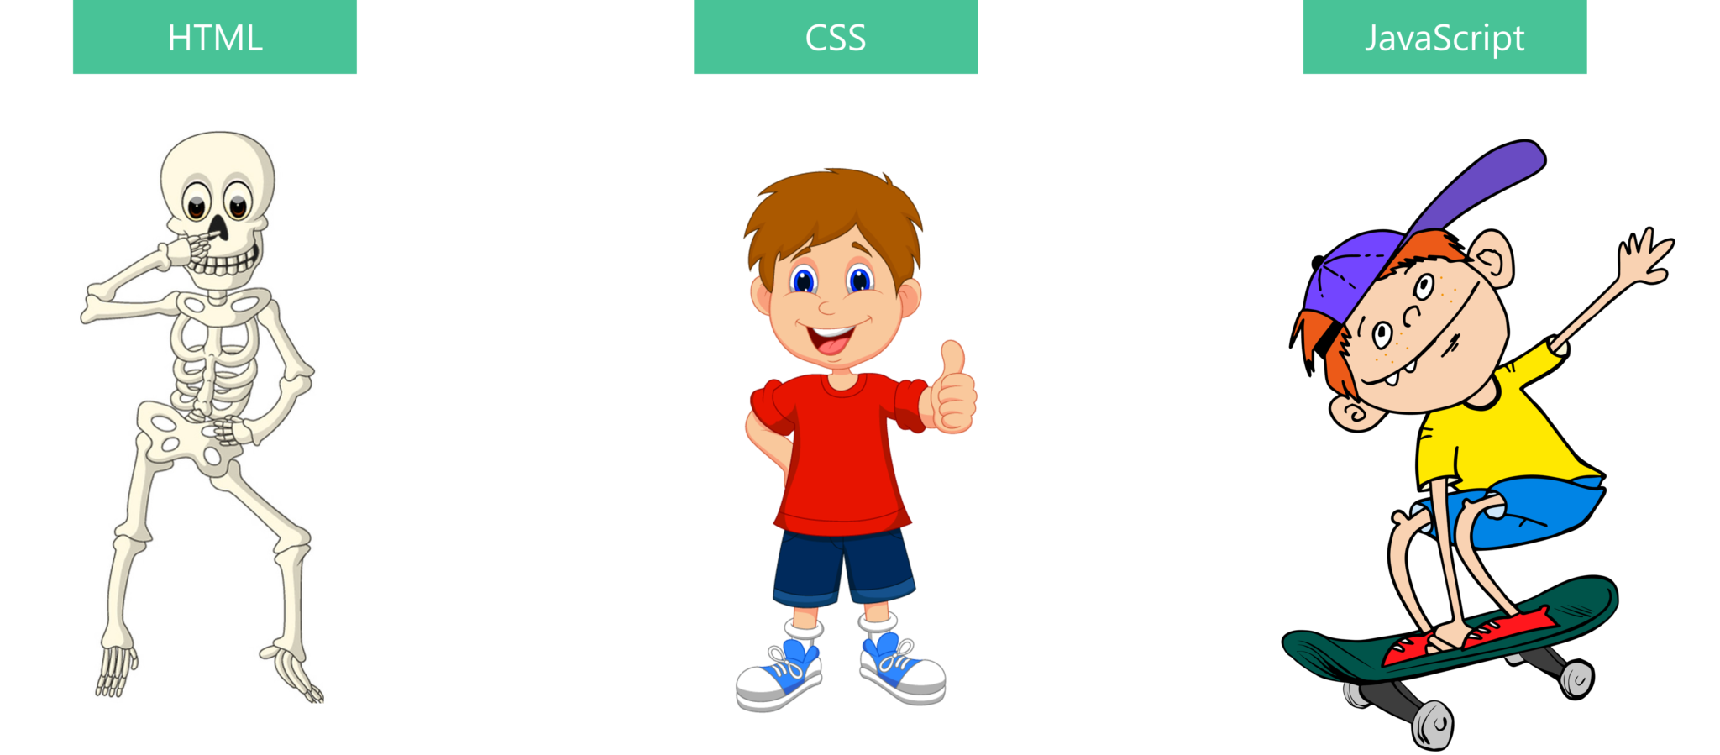
What does CSS adds?

Slide 5
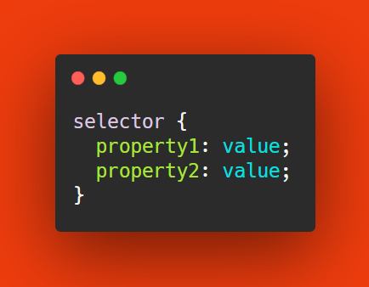
Understanding CSS Syntax
⚡ Selectors are used to start the CSS.
⚡Curly Braces are used to encompass all the Styles.
⚡We have Property-Value Pairs.
⚡Property defines Width, Height and other stuff.
⚡ Value defines the specificity behind that Property.

Slide 6
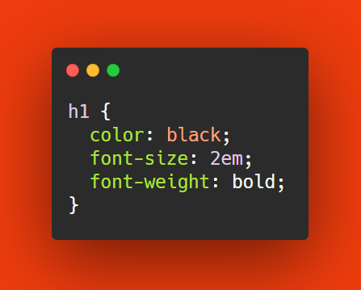
Let’s take an Example
⚡ Here the h1 Tag is taken as the Selector.
⚡ Properties are Color, Font Size and Font Weight.
⚡ We define the Properties and their Values.

Slide 7
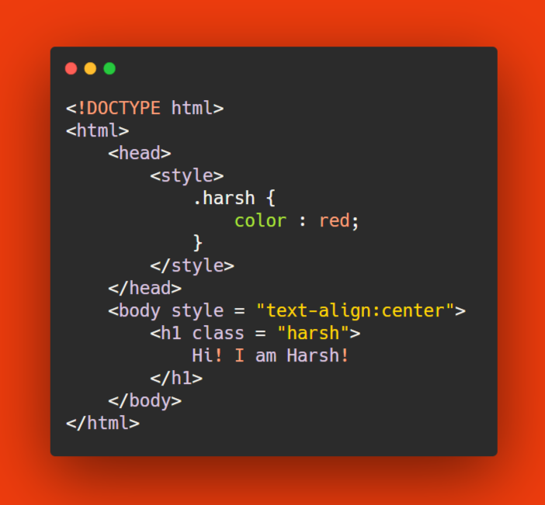
Class Selectors
⚡ Select all Elements of a Class Attribute.
⚡ Use (.) character to grab Class Attribute.
⚡ Best Practice for CSS Styling
⚡ Create reusable UI Components

Slide 8
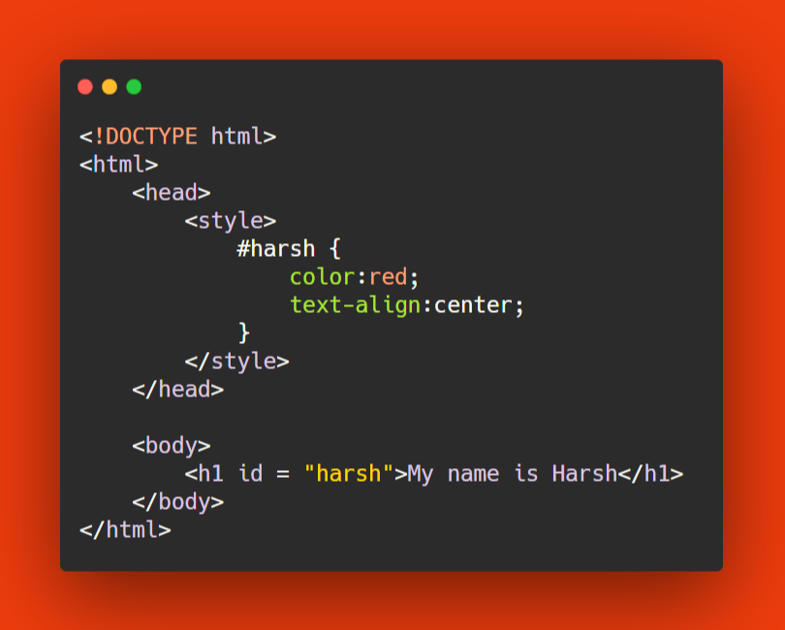
ID Selectors
⚡ Should be Unique in the HTML Document.
⚡ Used to style a given ID.
⚡ Used with a (#) Character.

Slide 9
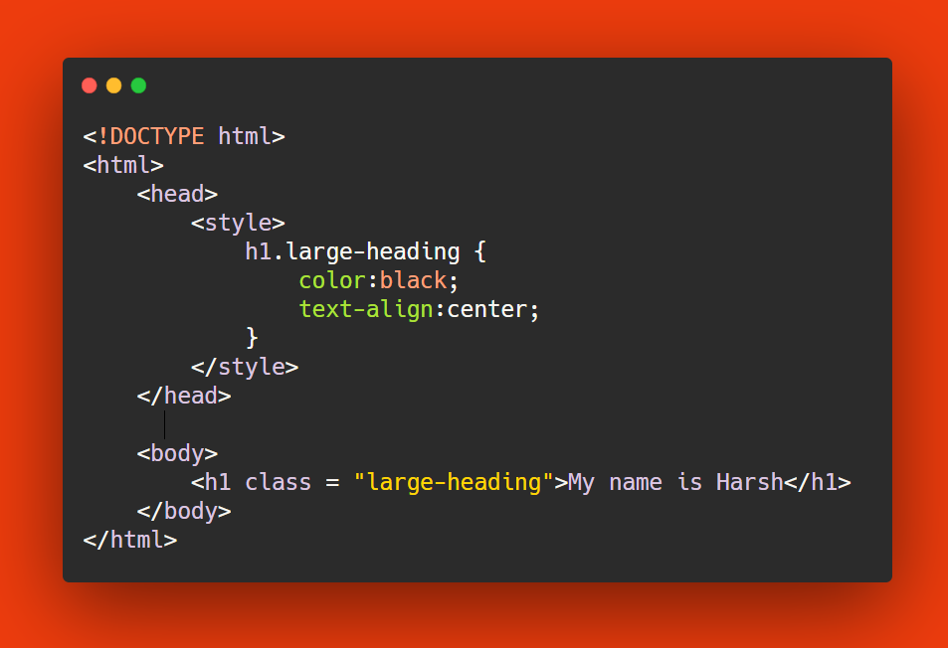
Combine Multiple Selectors
⚡ Combine Multiple Selectors as many times as you want.
⚡ Used to add CSS to multiple Components.

Slide 10
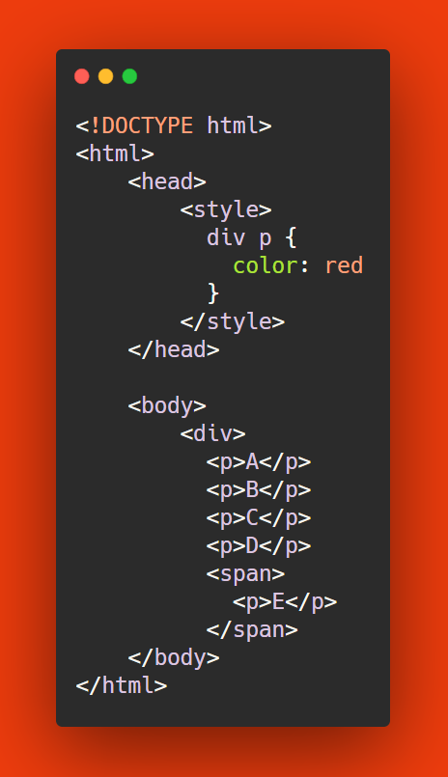
Ancestor and Child Selector
⚡ Specify the Ancestor of your Element.
⚡ Put a Space between Parent and Child Selector.
⚡ This will allow all Parent Selectors to be accessed directly by CSS selectors.

Slide 11
Ancestor and Child Selector
⚡ Specify the Ancestor of your Element.
⚡ Put a Space between Parent and Child Selector.
⚡ This will allow all Parent Selectors to be accessed directly by CSS selectors.

Slide 12
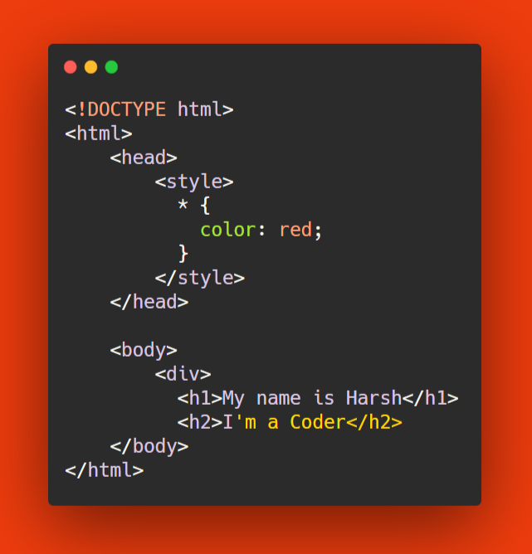
Wildcard Selector
⚡ Used to set Default for the entire Webpage
⚡Grabs all the Selectors on the HTML Page
⚡ Should be used only when needed.

Slide 13
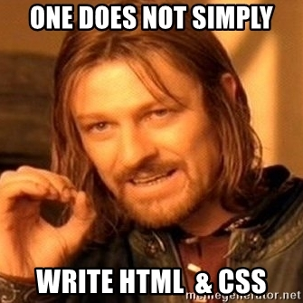
Inline CSS v/S Exline CSS
⚡ Inline CSS allows you to embed CSS into HTML.
⚡Exline CSS creates a seperate CSS File somewhere.
⚡ Better Dev Practices suggest using Exline CSS

Slide 14
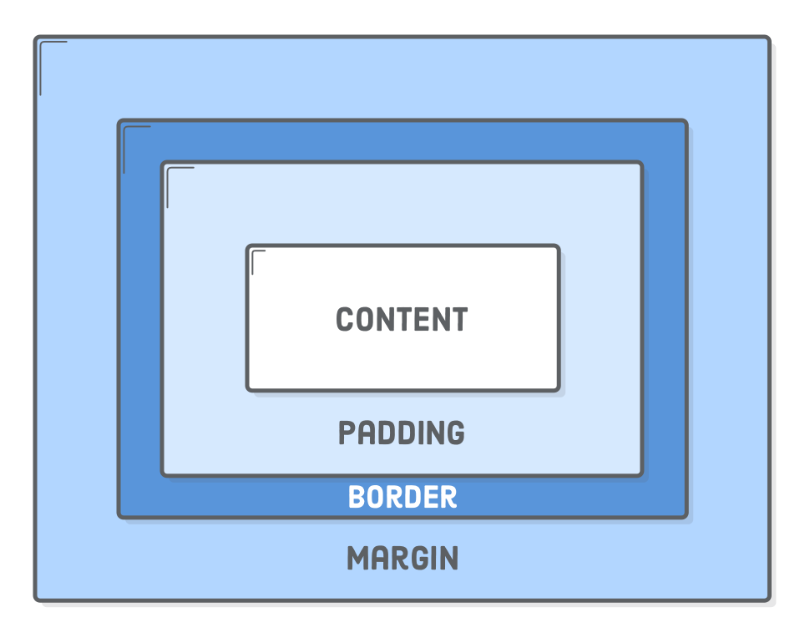
Understanding Box Model
⚡ All HTML Elements are considered as Boxes.
⚡ Content, Padding, Border and Margin are the main part in the Box Model.
⚡ It allows us to define spaces around Border aptly.

Slide 15

I don’t like writing CSS. What should I do?

Slide 16
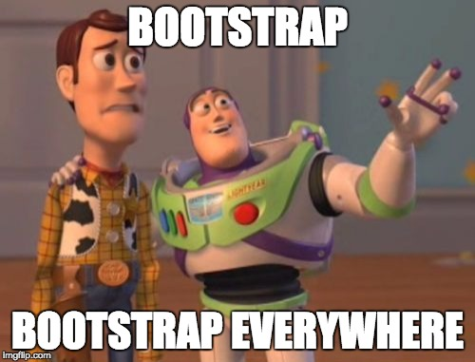
Why Bootstrap?
⚡ Write Less. Do more with Bootstrap.
⚡ Design and Implement using HTML.
⚡ Responsive-Web Design and Optimized for fast performance.

Slide 17
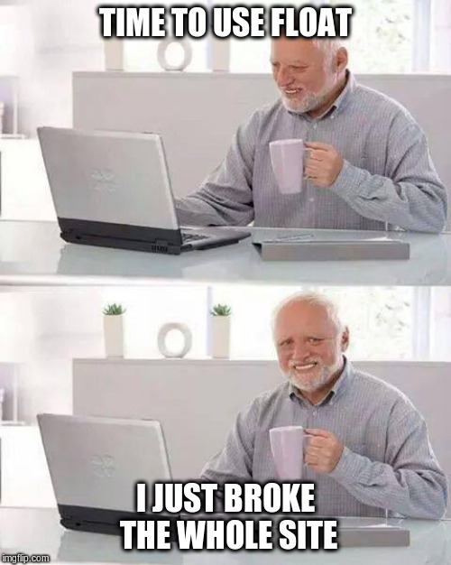
What alternative do I have?
⚡ Bulma CSS
⚡ Semantic UI
⚡ Materialize UI
⚡ Pure

Slide 18

Endpoint

